Slide 1
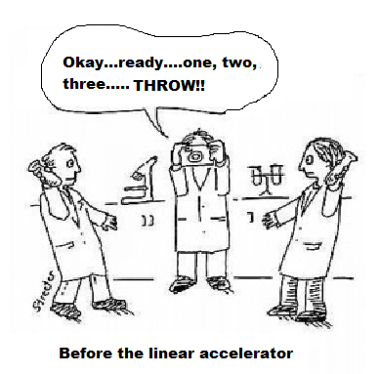
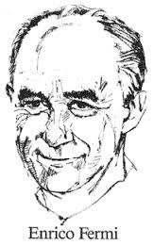
Welcome to Grade12 Physics!

Slide 2
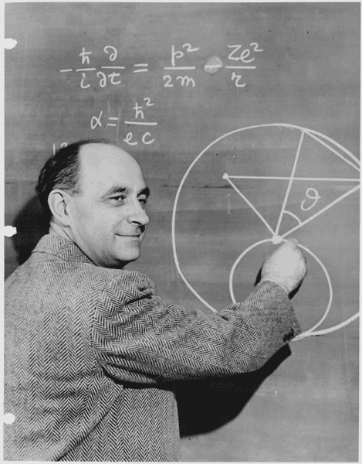
Fermi Question Challenge
Italian-born physicist Enrico Fermi was legendary for being able to solve problems that were not well defined!
He would estimate unknown quantities and then proceed to develop a logical solution using these estimates.
His goal was to find a reasonable
“order of magnitude” answer.
The process was more important than
the actual answer!!

Slide 3
1. How many water balloons could fill this room?
2. How many jelly beans could fill a 1 Litre jar?
3. How many dentists are there in Brampton?
4. How many steps would it take you to walk around the Earth?

